Slide 1
Design a Tesla Model S P85 Speed Controller
Prepared by:
Nishantkumar V Patel

Slide 2
About the Project
I Have done the project independetly and on my own on the platform of MATLAB & Simulink.
I have design the PID which is speed controller in this particular case to check and examine the different velocity outputs by doing the different gain values of PID tuning.
First of all, I have done some dynamics and forces calculations which are very necessary to take into account wile making the Simulink model.
I have made the equation for the brushed DC motor which is I used to put in this Tesla car hypothetically. (although 3-phase 4-pole AC induction motor is actually used in this car) to make the model little bit of simple to understand.
I did find the general characteristics of Tesla Model S car through the internet.
I assumed that the car will be moving at constant speed.I am not going to accelerate dor decelerate the car. Therefore; Inertia does not matter when the car is in constant speed.
I will simulate the model with one person (who driving the car) of having 72 kg body weight.
As we predefine the input as we want or reference input that is speed in kmph and then simulate the whole model to get the output of the model which will be vehicle speed in kmph.

Slide 3
General Characteristics of Car
P85 Battery is used.
16 Modules and 6 groups in each module.
85 KWh Battery Capacity.
3.6 V Nominal Cell Voltage
So Nominal Battery Voltage would be,
:. 3.6*6*16= 346 V
9.73 Gear Ratio
2108kg+72 kg= 2180 kg Total Car Weight
0.24 m Wheel Radius of car (including alloy and tyre width)
2.3 m² Frontal Area of car
0.02 Coefficient of Friction (on asphalt/ dry road)
0.24 Drag Coefficient
1.225 kg/m³ Air Density
Motor specifications:
Resistence(R)= 5.3*10⁻³ Ohms
Inductance(L)= 493*10⁻⁹ Henry
Emf Constant(K_{E})= 0.12 Vs/ rad
Torque Constant(Kt)= 0.25 Nm/Amp
310 KW Motor Power
600 Nm Motor Torque

Slide 4
Car Diagram for making Simulink Model
Speed Controller
Brushed DC Motor
Wheel Dynamics
INPUT
Battery
Moving Force
Rolling Resistence
Vehicle Body Dynamics
e.g. Velocity, Torque, Acceleration
Car Inertia
Aerodynamic Drag

Slide 5
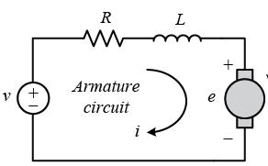
Mathematical Calculations
A.) DC Motor Calculation:
As you can see this is the simple diagram for the DC motor.
v is represents the applied voltage, e is emf (electro motive force) induced inside the motor.
Applied voltage (v) is directly proportional to rotational velocity of the motor. Whereas, applied(i) current is proportional to torque of the motor.
Thus, ultimately by regulating or fluctuating the voltage we can change the motor speed and consecutively the wheel velocity or vehicle speed.
According to kirchoff law applied in this circuit,
:. v= i(t)R + L[di(t)/dt] + e(t)
As the current is directly proportional to motor torque,
:. T = Kt*i(t)
Now, converting the above equation from Time-domain to Frequency-domain or S-domain. For that purpose we need the Laplace tranform approach.
:. V(s)= R*I(s) + sL*I(s) + K_{E}*⍵(s)
:. I(s)= [V(s)- K_{E}*⍵(s)]/ (R+ sL) putting I(s) into T(s) euqation.
:. T(s)= K_{t}*I(s)
:. T(s)= K_{t}* [V(s)- K_{E}*⍵(s)]/ (R+ sL)

Slide 6
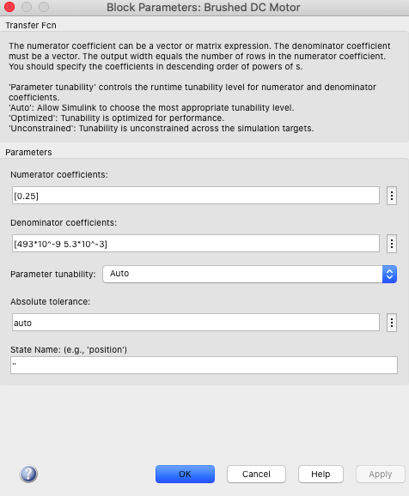
The brushed dc motor is represented by Transfer function block in Simulink. The above, one can see that I put the values of Inductance, Resistence and Torque Constant (Kt) values in the frequency domain.
In Simulink;
Numerator= [S⁰] with coefficient [0.25]
Denominator= [S¹ S⁰] with coefficients [493*10⁻⁹ 5.3*10⁻³]
means;
= (0.25)/ (s 493*10⁻⁹ + 5.3*10⁻³) In equation.

Slide 7
B.) Tractive Force/ Wheel Dynamics:
F_{T}= Tractive/ Traction Force (N)
T= Motor Torque
R_{w}= Wheel Radius = 0.24 m
G_{r}= Gear Ratio= 9.73
:. F_{T}= (T/ R_{w})* G_{r}
:. F_{T}= (40.54*T)
:. F_{T}= 0.6*(40.54*T) N
The Transimssion/ Mechanical efficiecny I assumed is 60 %. Because there are heat, frictional, transmission losses as well as slipping need to consider for making the model more realistic.
C.) Aerodynamic Drag:
D= Aerodynamic Drag force (N)
A= Frontal Area= 2.3 m²
C_{d}= Drag coefficient= 0.24
ρ= Air Density= 1.225 kg/ m³
:. F_{A} = 0.5*ρ*A*V²* C_{d}
:. F_{A}= (0.3381 V²) N
The aerodyanmic drag is also need to take into account as it becomes significant when the car is at moving state.

Slide 8
D.) Rolling Resistence:
Fr= Rolling Resistence force (N)
m_{t}= Total Car Weight including person= 2180 kg
G= Gravitational Constant= 9.81 m/s²
Cr= Coefficient of rolling resistence= 0.02 (for asphalt/ dry road)
:. Fr= Cr*mt*g
:. Fr= (4237.7) N
Total Forces acting on vehicle (ΣF)= F_{T} + F_{A} + Fr
According to Newton‘s Second Law of Motion,
:. ΣF= m*a
:. [(0.7*40.54*T) – (427.7) – (0.3381V²)]= m_{t}*(dV/dt
:. (dV/dt)= [(0.6*40.54*T) – (427.7) – (0.3381*V²)]/ 2180
This equation- X is in Time-domian.
X

Slide 9
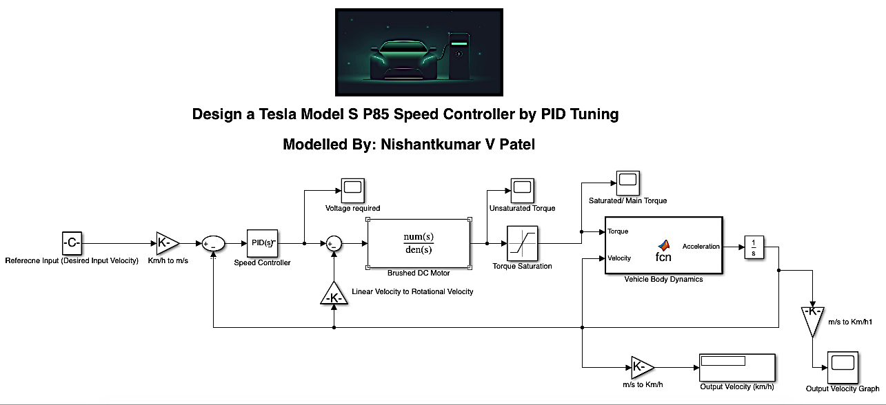
Setting Up the Closed Loop Simulink Model

Slide 10
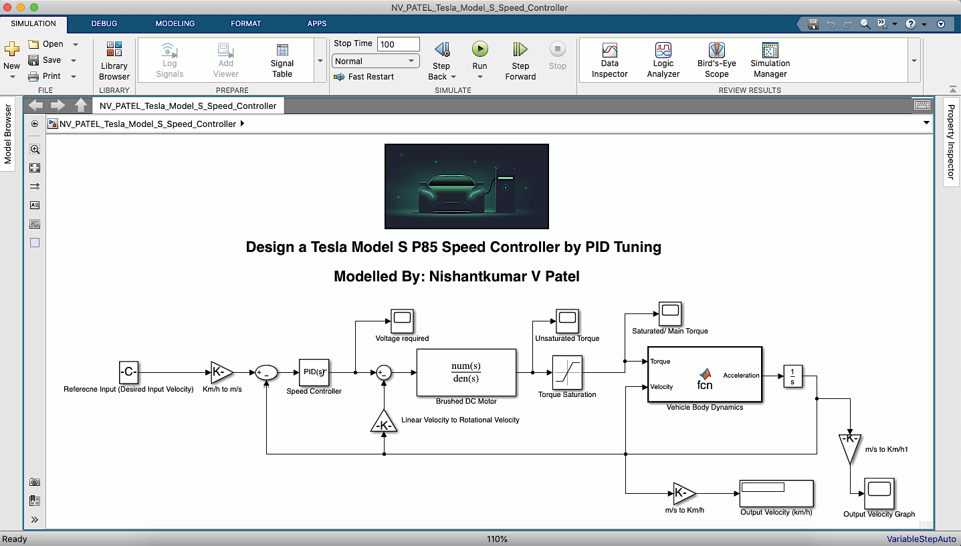

Slide 11
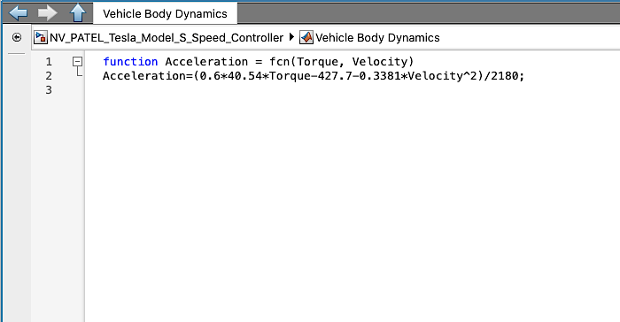
I made a MATLAB Function in which I have defined the equation- A which is calculated previously.
As you can see, this function takes Torque and Velocity (which are unknown quantity) as Input and at the end by doing some calculations it gives the Acceleration (dV/dt) as output.
The beauty about the MATLAB & Simulink software is it automatically convert the time-domain to frequency-domain and vice versa.

Slide 12
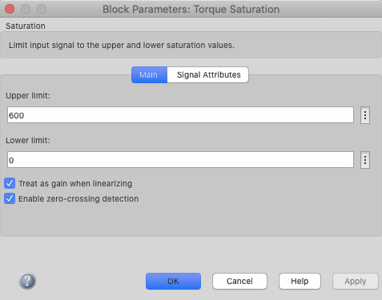
As, the specified maximum torque of the Tesla Model S car is 600 Nm. So, I saturated the Torque limits ranges from 0 to 600. So, that we can get the appropriate and reasonalbe output.

Slide 13
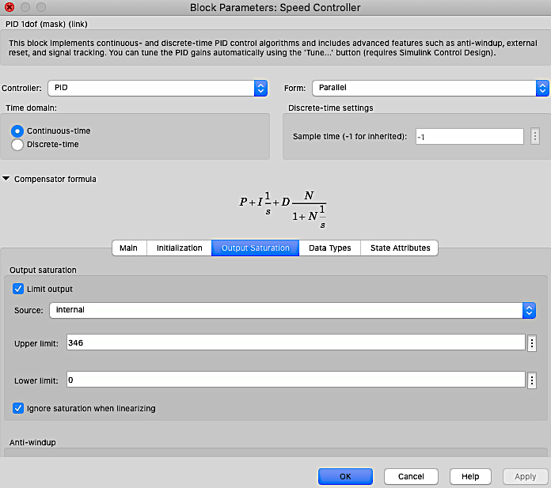
As per the battery calculations 346 V is maximum voltages Tesla Model S P85 battery can produce. So, as we have discussed before the voltage is the deciding factor to regulate and control the speed of vehicle.
So, here I set the limits for PID Controller to tune always between 0 to 346 V. Otherwise the PID Tuner goes beyond the 346 value which is not valid to make a realistic simulink model.
So, here PID Contoller acts as a voltage controller or voltage regulator which is ultimately acts as so called Speed Controller.

Slide 14
About PID Controller
The PID controller is basically works on time as well as frequency domain.
By means of tuning the PID contrtoller means changes the Gain values of Proportional, Integral and Derivative parameters seperately.
The main fucntion of PID controller is to minimize the error by these parameters. Each of parameters have a different role to control the error value.
The error is the difference between the Reference Speed Input we want and feed to oput model and Actual Speed Output this simulink model offers which we get afterward by runing and simulating the it.
Error= (Reference Speed Input – Actual Speed Output)
This error is removed by the PID controller gradually with time.
So, one can achieve the actual vehicle speed as output the Reference speed input as he/ she wants and expects from vehicle by delivering and feeding to model. To make possible the expectations of driver PID controller comes into picture and helps the model to achieve the output that driver tells the model to give.
How PID controller helps the vehicle model to achieve this kind of things? So for that purpose, one needs to tune the PID parameters in a best possible way to make appropriate.
Here, I also mentioned the output saturation of the anti wind-up methods e.g. none, clamping to get the most possible adequate results.

Slide 15
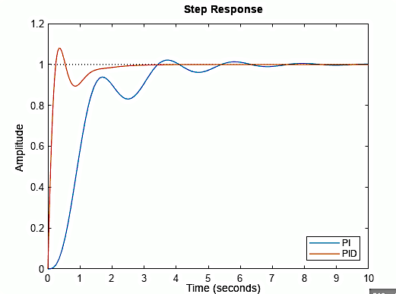
O
D
Proportional: The proportional parameter trys to minimize the error very at initially shown in P-circle untill the steady state error left. So, it is important to keep the proportional gain value high to reach the error very close to zero as fast as possible.
Integral: The Integral keeps increasing and bring the error to zero in closed loop system. It acts on the integrated error and try to reduce the error and bring to zero.
Derivative: The derivative factor try to minimize the error which will occurred in the future. Becuase this parameter derive the error with time So, it breaks down the error and then eliminate. As one can see that without derivate factor only in PI the error is still there afterwards once the system becomes stabilize as seen in D-circle in figure. But in PID the error gets removed afterwards once the system becoms stabilize as seen in the same D-circle.
Clamping method try to eliminate the overshoot as well as undershoot shown in O-circle and U-circle respectively. Because these methods put the limits on the Integral and Derivative parameters which soemtimes bring the error above or below zero.
U
P

Slide 16
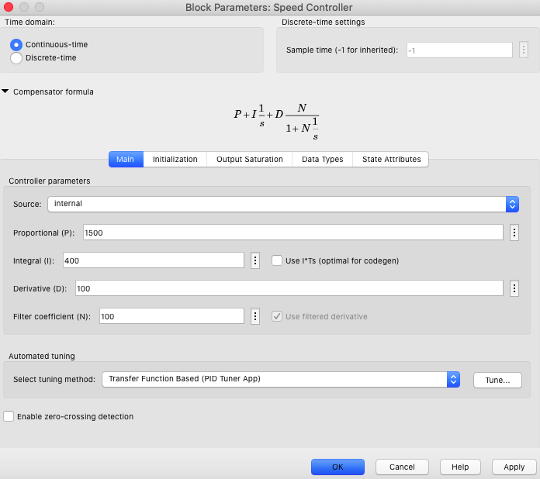
Different PID Tuning for Testing the Speed Controller
Case-1: without Clamping (if Driver wants 100 kmph speed)
I have set the Proportional gain value(P) at 1500 and Integral value(I) at 400. The derivate gain(D) is 100.The Filter Coefficient(N) at 100. without clamping and without zero-crossing detection.
Let us see the output velocity graph.

Slide 17
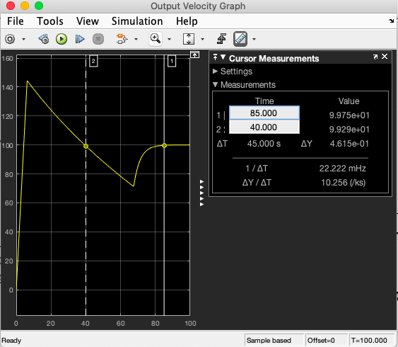
Output Velocity graph depicts that at the very starting the Proportional parameter try to reduce the error right after the steady state error is left to reduce where the Integral parameter comes into action and try to reduce the lefted steady state error which eventually reduce that much of error that it goes down below 100 kmph at 40 seconds then it realizes to reduce itself and again goes up near to 100 kmph and at the end at around 85 seconds it touches the exact velocity which it is told by the driver to obtain.
This is occur due to lack of anti wind up and zero-crossing detection it ramps up and down from the target speed.
Here, the controller takes approximately about 85 seconds to reach the target speed at mentioned tuning values.

Slide 18
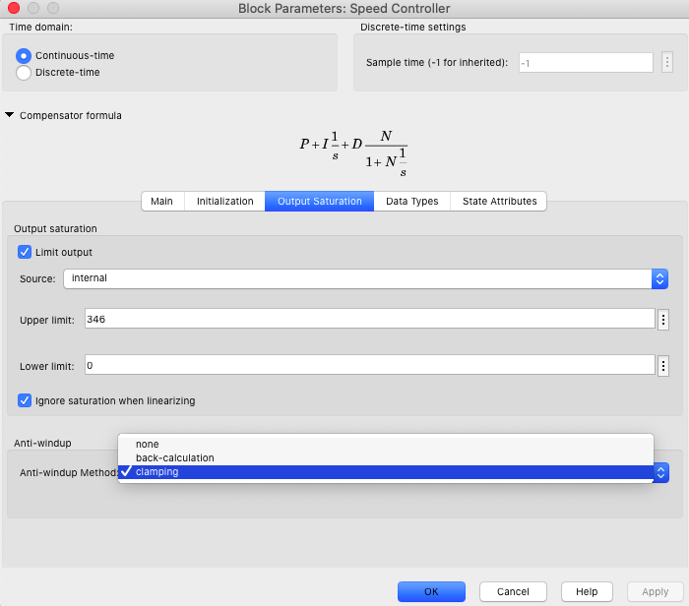
Case-2: with Clamping (if Driver wants 100 kmph speed)
Now enable the zer-crossing detection and clamping in this case to see what will be the result.

Slide 19
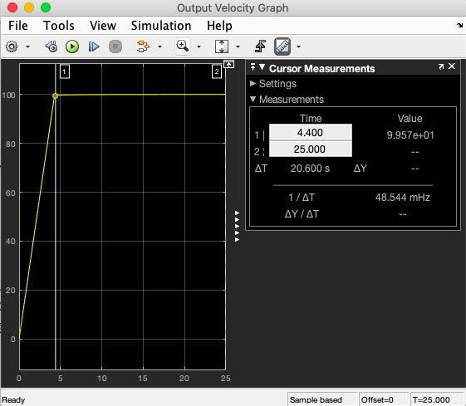
Now, one can observed that the graph has became very smooth and uniform try to reach to target speed without any overshoot or undershooting. At about 4.4 seconds the car reach 100 kmph speed.
So, here in this case PID controller takes roughly about 4.4 s to minimize the error with the same tuning values as taken in previous case-1, but including clamping and zero cross detection.

Slide 20
I have neglected the Inertia because as I said I pressumed the vehicle at constant speed or in moving condition. So, for that inertia can be neglected.
By this simulink model which I have made, the driver can achieve any speed he or she wants whether it is 100 kmph or 60 kmph or 150 kmph.
I have tried my best to make it as much as realistic.

